Slide 1
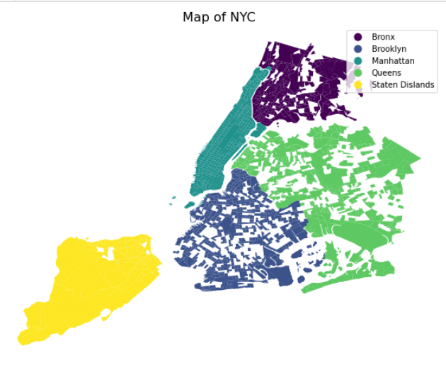

Spatio-temporal Change of COVID-19’s Impact on Mobility Pattern in NYC
Xiaoyi Wu
2022/04/12
Notes:
2-min introduction
Problem-current way vs method- results

Slide 2
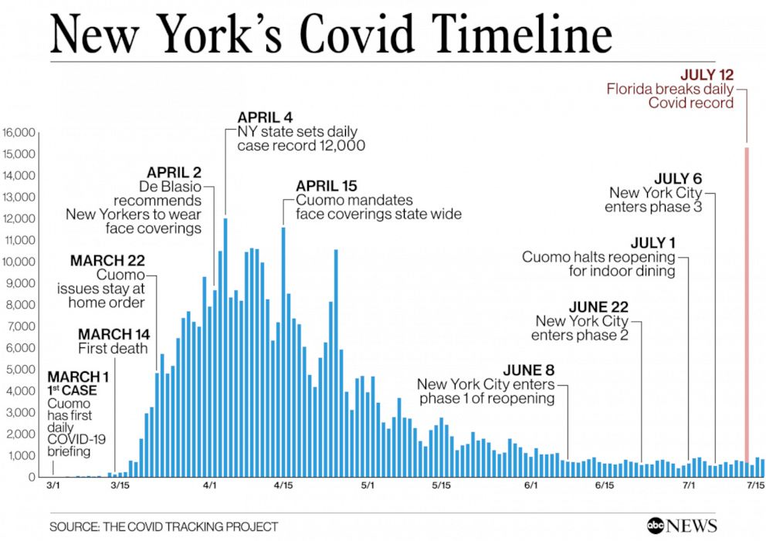
Motivation
Before / During / After COVID-19
March 2019 / March 2020 / March 2021
What are the places people usually visit?
How long they stay?
Where are they from? Where are they to?
Spatio-termporal changes of customer preference?
Travel behaviors and necessary needs/services get satisfiied in different contexts?
Political implications?
Source: ABC News
Notes:
Overview of master program
In-class projects
Choose one which is deepest
Starting with the research problem, how to do, results

Slide 3
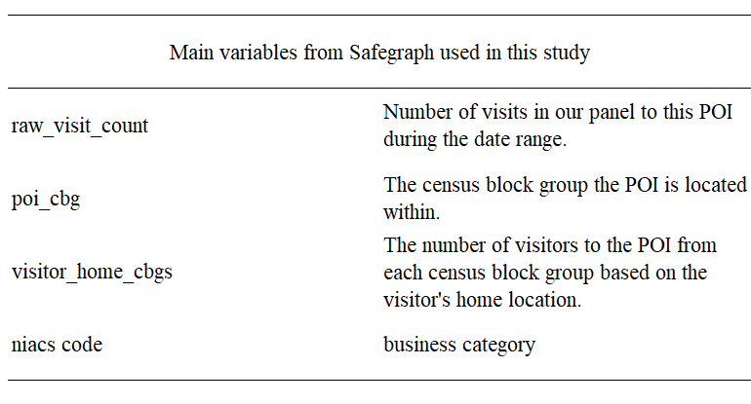
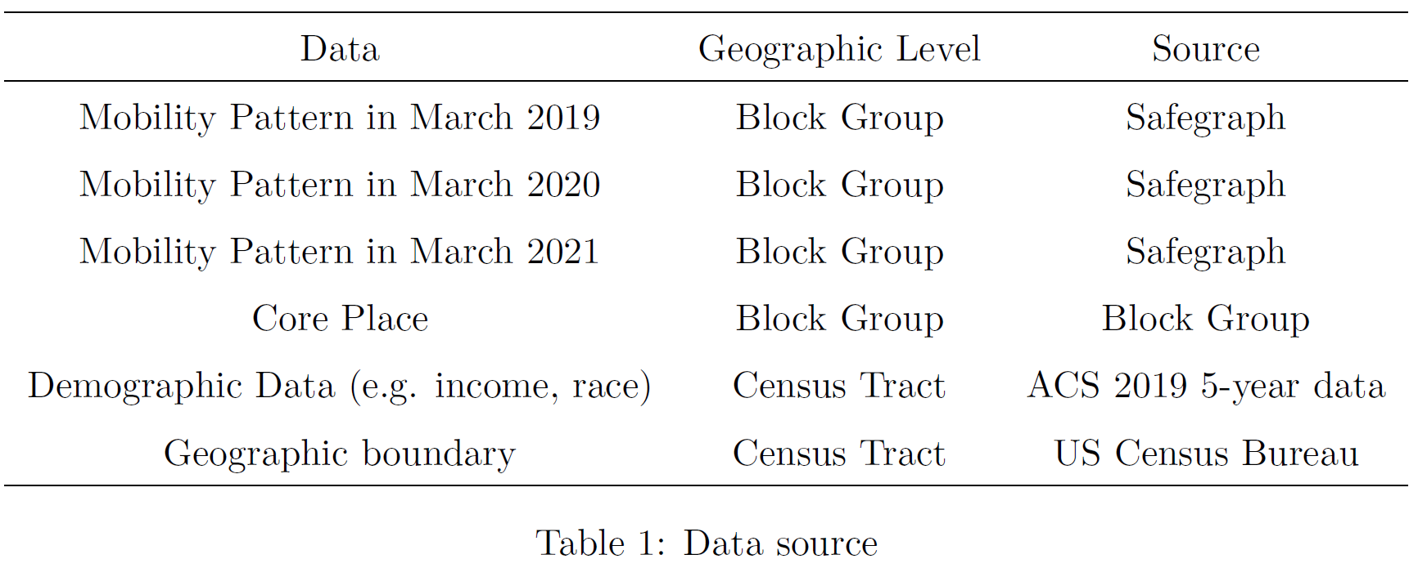
Data source

Slide 4
Pipeline
Data Process
Temporal Analysis
Change Rate Calculation
Spatial Analysis
Join with Geometry
Demographic Analysis
Join with ACS data
Notes:
Overview of master program
In-class projects
Choose one which is deepest
Starting with the research problem, how to do, results

Slide 5
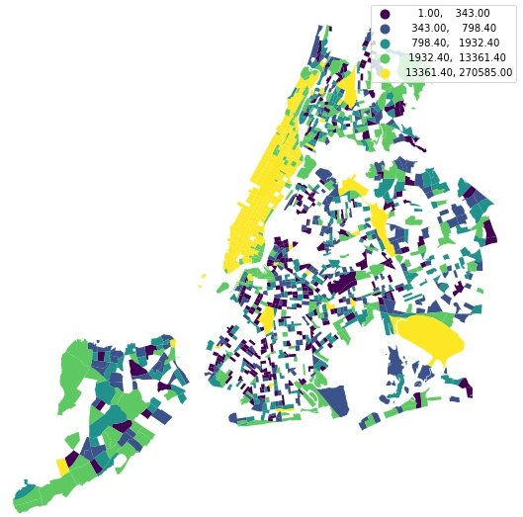
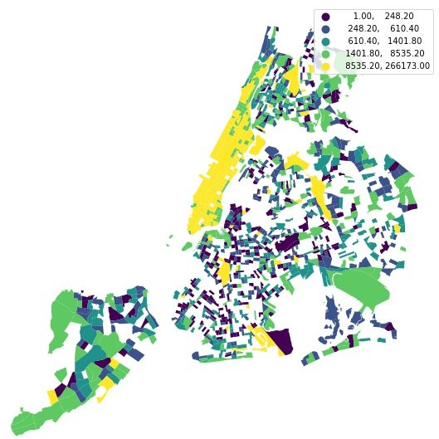
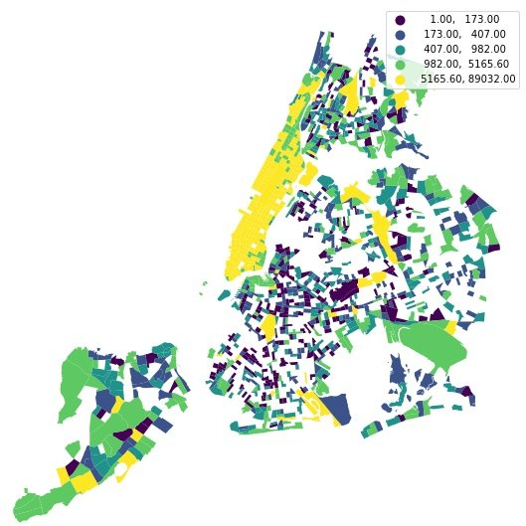
1. Spatial Analysis
March 2019
March 2020
March 2021
Figure : Visit count in different years
Clustering pattern of high volume of visitors and visit count in mid and lower Manhattan, areas around John F. Kennedy (JFK) International/ LaGuardia Airport: LGA

Slide 6
1. Spatial Analysis
March 2019
March 2020
March 2021
Figure : Visit count in different years
Clustering pattern of high volume of visitors and visit count in mid and lower Manhattan, areas around John F. Kennedy (JFK) International/ LaGuardia Airport: LGA

Slide 7
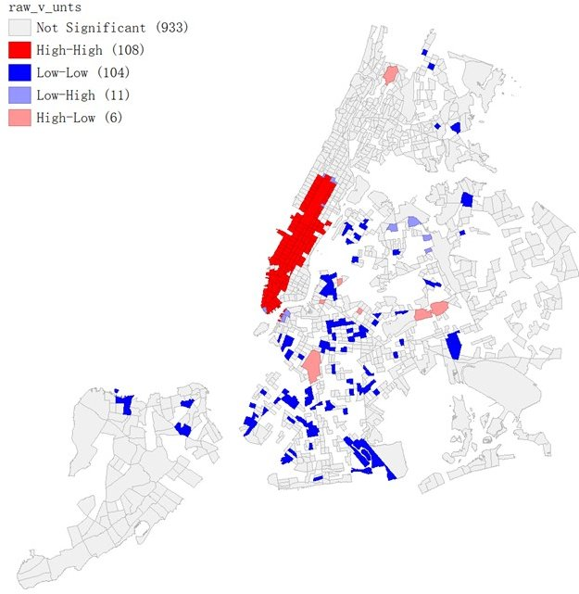
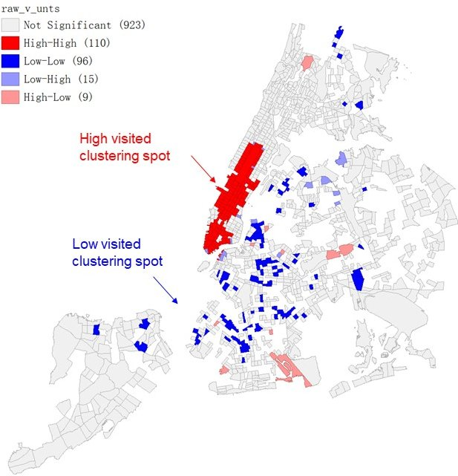
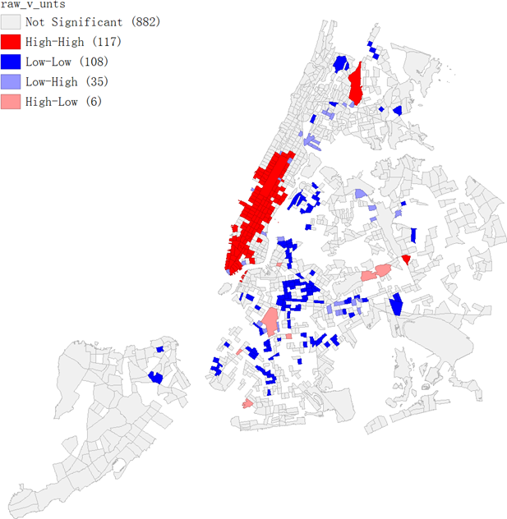
1. Spatial Analysis
March 2019
March 2020
March 2021
Figure : Clustering map with local Moran’s I statistics

Slide 8
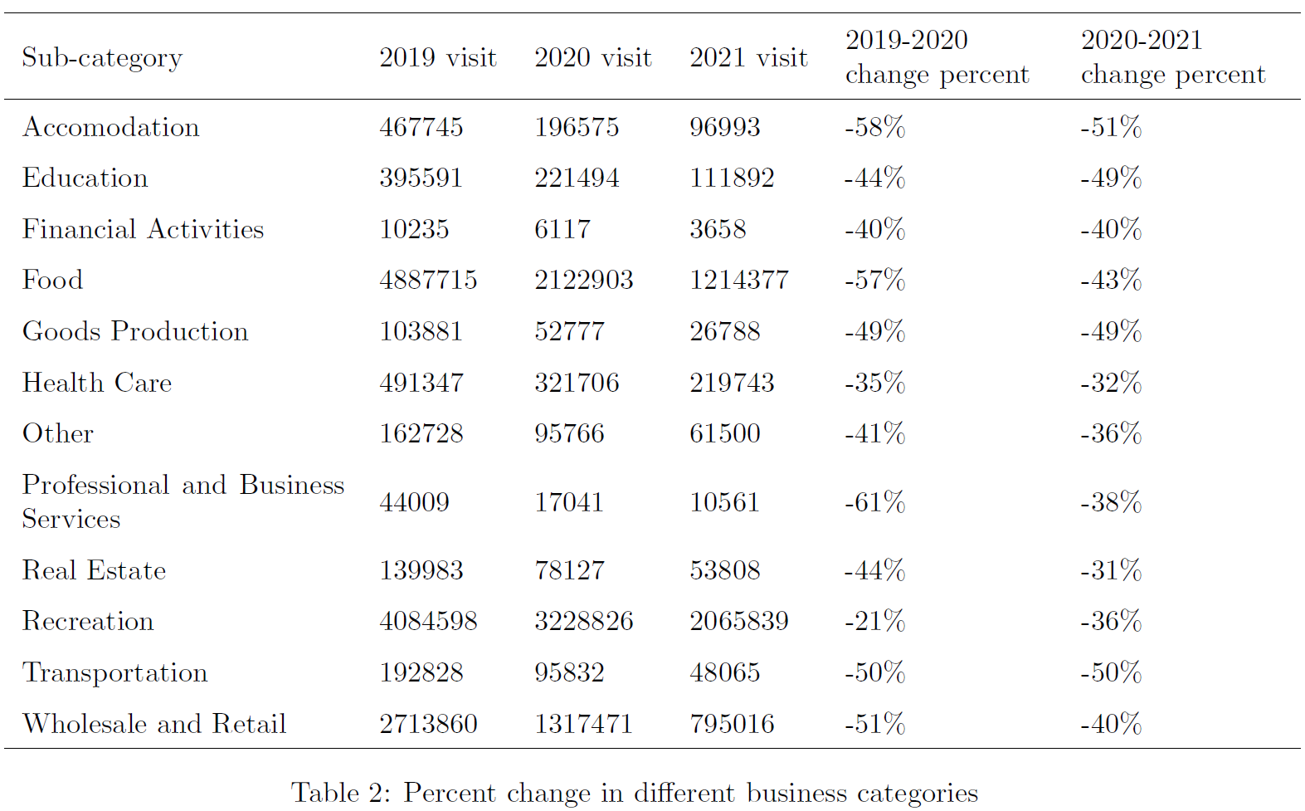
1. Temporal Analysis

Slide 9
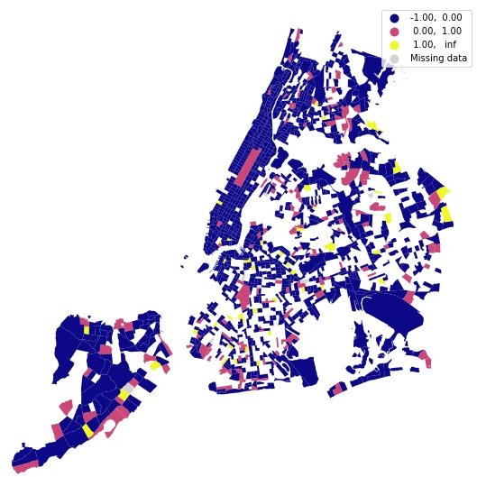
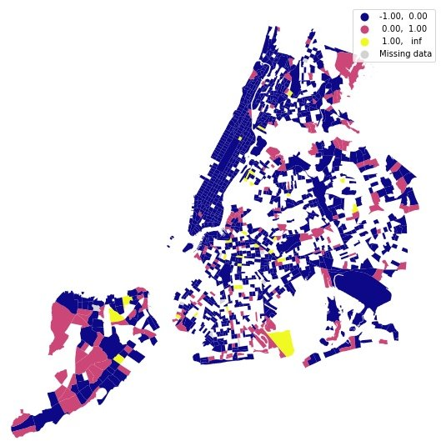
1. Total
From Mach 2019 to March 2020
From March 2020 to March 2021
Change percentage in total visit count

Slide 10
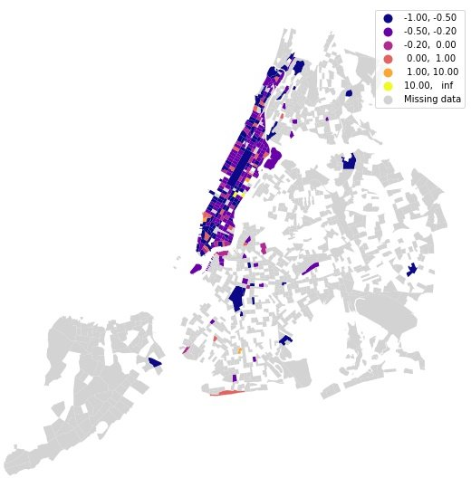

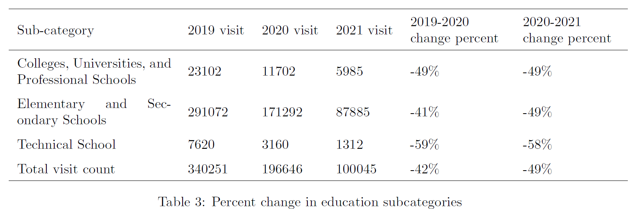
1. Education
From Mach 2019 to March 2020
From March 2020 to March 2021
Change percentage in visit count in education

Slide 11
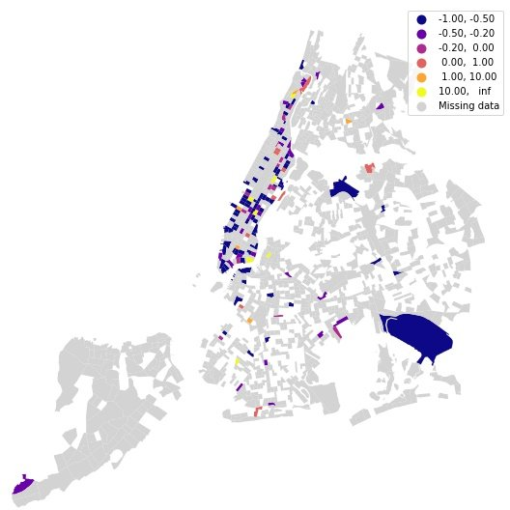
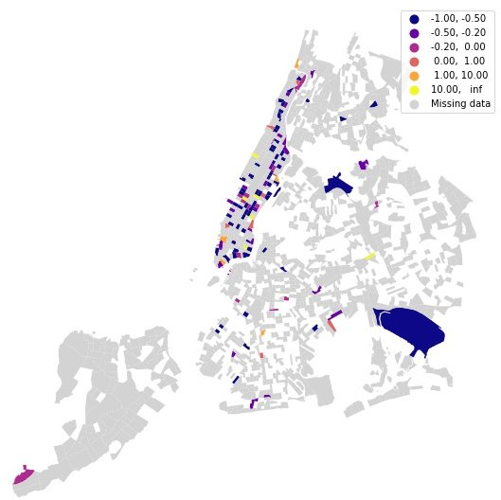
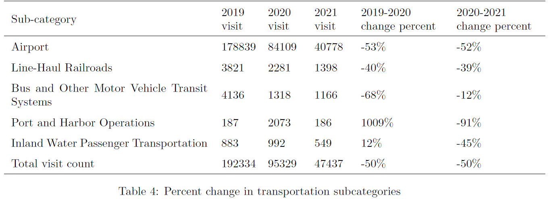
2. Transportation
From Mach 2019 to March 2020
From March 2020 to March 2021
Change percentage in visit count in transportation

Slide 12
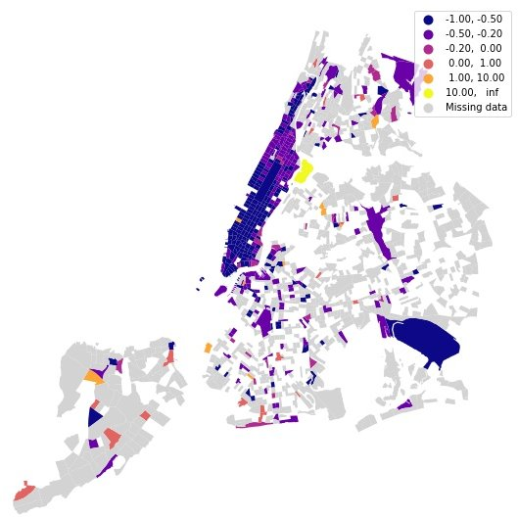
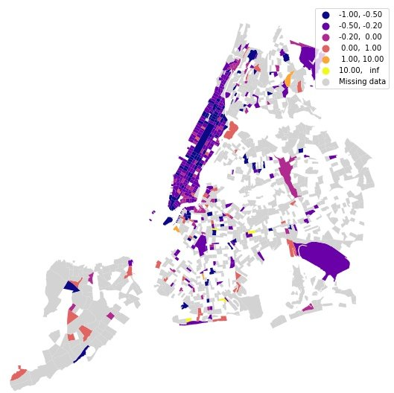
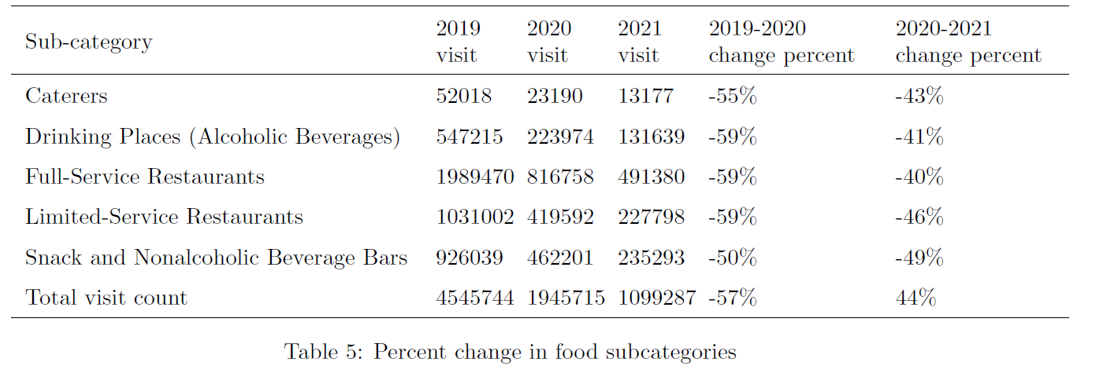
3. Food
From Mach 2019 to March 2020
From March 2020 to March 2021
Change percentage in visit count in food

Slide 13
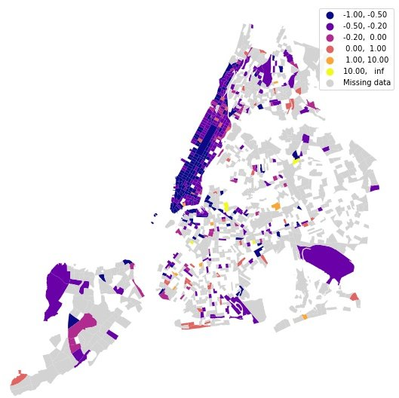
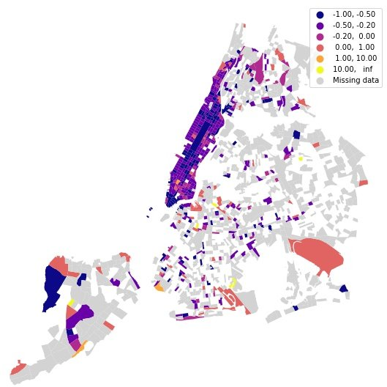
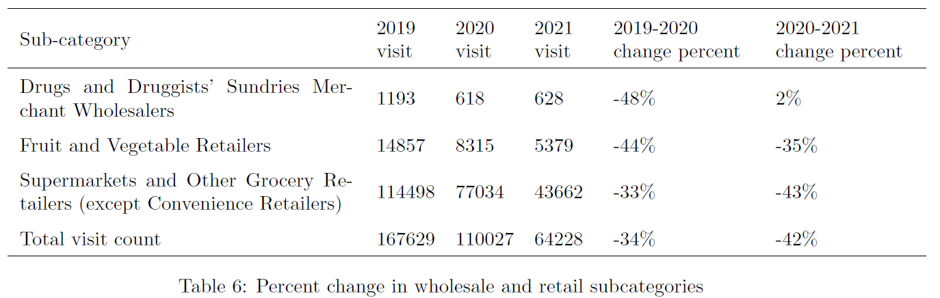
4. Wholesale and Retail
From Mach 2019 to March 2020
From March 2020 to March 2021
Change percentage in visit count in wholesale and retail

Slide 14
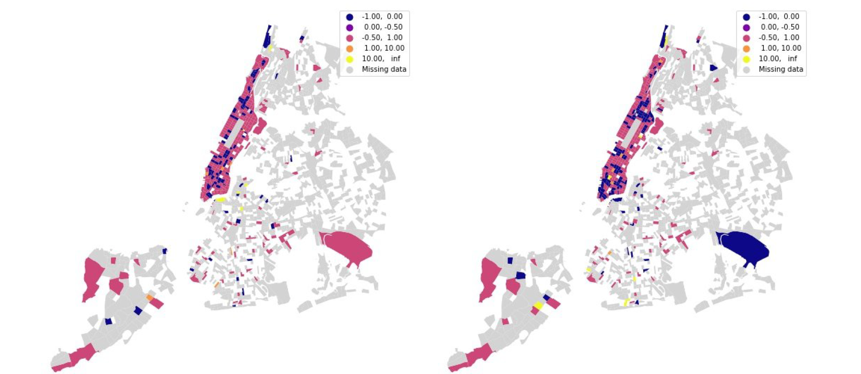
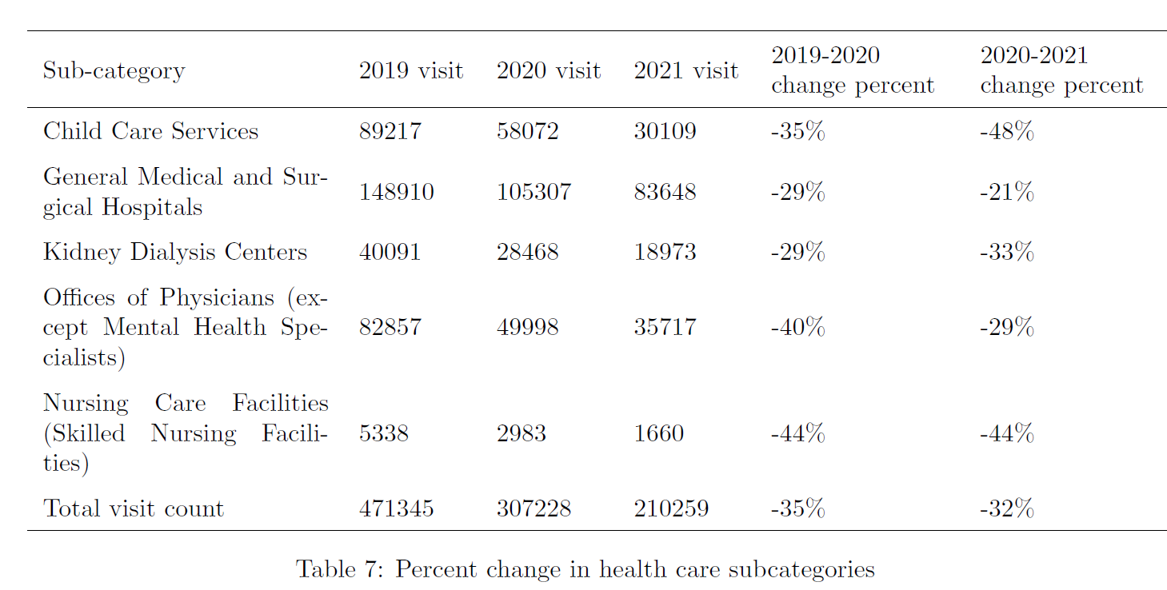
4. Health Care
From March 2019 to March 2020
From March 2020 to March 2021
Change percentage in visit count in health care

Slide 15
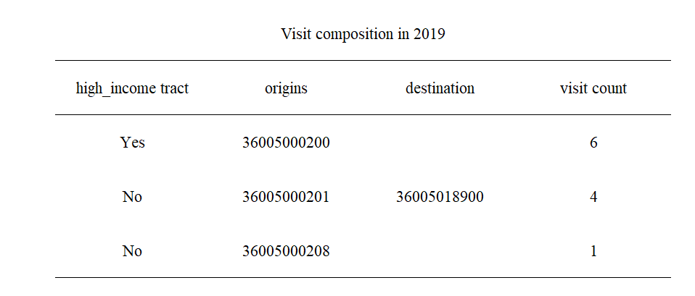
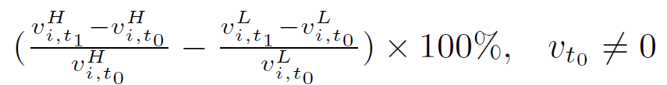
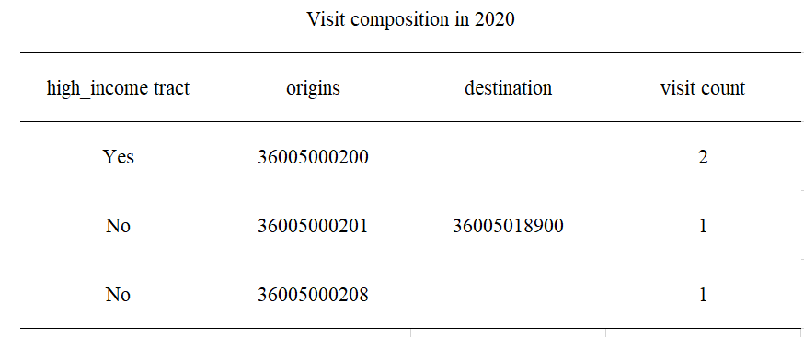
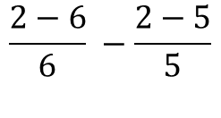
3. Socio-economic Analysis
Change degree in different income groups=
If the difference is >=0, indicating:
Low-income groups decreased their mobility in larger degree
High-income groups increased their visit rate in larger degree
$$\frac{2−6}{6} −\frac{2−5}{5}$$

Slide 16
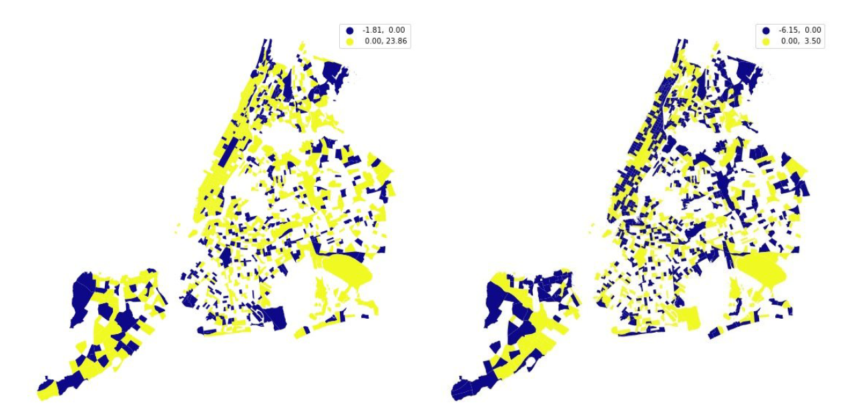
3. Socio-economic Analysis
If the color is yellow, indicating:
Low-income groups decreased their mobility in larger degree
High-income groups increased their visit rate in larger degree
From Mach 2019 to March 2020
From March 2020 to March 2021

Slide 17
Future Work
Do a regression analysis where your outcome variables are changes over time (e.g., 2021 visit counts per block group - 2019 visit counts per block group), and your predictors are various socioeconomic variables (e.g., poverty, income, house price, etc.) for the year 2019 (or latest available year).
Do a k-means cluster analysis of different socioeconomic variables (poverty, income, house price, etc.) to (hopefully) identify high/medium/low SES block groups.

